Slide 1
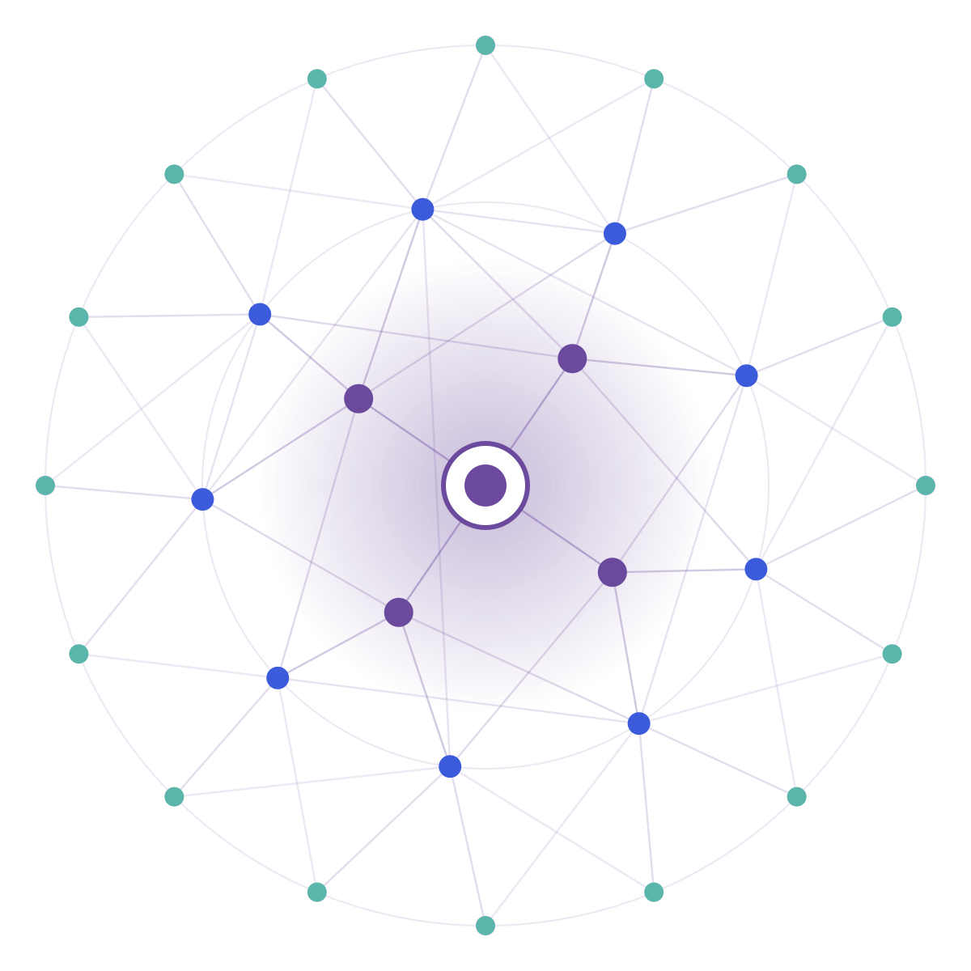
SAMSUNG PRISM
Generative AI
Hackathon
3rd Edition 2026 – 27
Theme
02 — Guided Troubleshooting
Team
ANCHOR
College
SRM Institute of Science and Technology
Members
Vedaang Pratap Singh • Mayank Singh • Maitri Tyagi • Aryaman Narain Pandey
Project
Proof-Carrying Troubleshooting Engine
PROOF-CARRYING TROUBLESHOOTING
GitHub
github.com/AryamanPandey-art/ANCHOR

Slide 2
Theme
THEME 02
Samsung's target
Smart Guided Troubleshooting Engine
Structured REST API • reusable mapping • fast-path cache
Turn a vague device complaint into clean, ordered troubleshooting steps — then map each step to the exact Galaxy Settings action.
Our interpretation
Evidence-first generation with deterministic verification before anything reaches the user.
Core question
How do we make an LLM useful for troubleshooting without letting it invent the fix?

Slide 3
Existing solutions & gaps
Manual support search
Generic LLM / RAG
Static FAQ flows
Agent searches documentation, rewrites steps, then the customer hunts through Settings.
Can explain symptoms well, but may produce unsupported steps or the wrong Settings direction.
Reliable for known wording, weaker when users paraphrase.
The gap
GROUNDING
Every troubleshooting step must come from SIIS evidence.
ACTIONABILITY
The answer should lead to the correct Settings screen.
DIRECTION SAFETY
“Turn on” and “turn off” are different actions.
SPEED
Repeated and paraphrased requests should reuse validated work.

Slide 4
Our solution & architecture
1
2
3
4
5
6
7
QUERY
INTENT
SIIS
LLM
VERIFY
DEEPLINK
CACHE
Natural-language complaint
Direction + state
Relevant evidence
Candidate actions
Grounding + direction
Catalog resolution
Validated response
DETERMINISTIC GATE
SIIS support
Direction match
Schema validity
No URL leakage
Design principle: the LLM proposes; deterministic code decides what is allowed to ship.

Slide 5
Demo & product walkthrough
LIVE CASE
“Turn on Touch Sensitivity”
01 Evidence
02 Action
03 One-tap path
SIIS: Touchscreen issues on a Galaxy phone or tablet
Grounded action: Touch Sensitivity
Catalog match →
bixby://masked/act/1b0d34e9b4
Relevant step: Touch Sensitivity Setting
Only steps supported by the supplied SIIS response are retained.
No normal URL is emitted.
What the judge sees
Query
→
Grounded SIIS evidence
→
Structured action
→
Verified Settings deeplink
→
Schema-valid response

Slide 6
Tools & tech stack
API
AI
Python 3.10+ • FastAPI • Uvicorn
LLM reasoning • query intent • action extraction
GROUNDING
VERIFICATION
SIIS parser • relevance filtering • evidence selection
Pydantic v2 • deterministic contract checks
DEEPLINKS
FRONTEND
578-entry masked catalog • semantic matching
Vue 3 • Vite • Axios
PERFORMANCE
TESTING
Validated-response cache • paraphrase-aware reuse
pytest • benchmark harness • URL/schema scans

Slide 7
Impact & use cases
From “what should I do?” to “here is the supported action.”
Customer support
Voice assistants
Knowledge operations
Convert vague complaints into consistent, actionable troubleshooting guides.
Turn assistant-generated guidance into a direct Settings action.
Reuse validated mappings across thousands of troubleshooting cases.
Why this matters
Less manual interpretation between the complaint and the fix.
A safer boundary between generative reasoning and device actions.
A reusable API contract suitable for automated evaluation and future worklet integration.

Slide 8
Innovation, results & limitations
20/20
86
0
0
7.35
schema-valid benchmark queries
verified actions
direction mismatches
URL leakages
ms avg. latency
Innovation: evidence-to-action grounding
Limitations
The LLM proposes candidates; ANCHOR filters them against SIIS evidence, direction/state, deeplink semantics and the response contract.
Coverage depends on the supplied SIIS evidence and the masked deeplink catalog. Actions without supporting evidence or a catalog match are not shipped.
Results from the 20-query benchmark harness.

Slide 9
What’s next
01
Broader deeplink coverage
Expand semantic matching and validation coverage across more Settings actions.
02
Stronger semantic cache
Use intent/state-aware similarity so paraphrases reuse validated responses safely.
03
Production worklet path
Connect the API contract to Samsung assistant workflows and operational telemetry.
04
More validation signals
Add richer post-action checks where the catalog exposes readable setting state.

Slide 10
Brownie points (differentiation)
What makes ANCHOR different
 | GENERIC LLM / RAG | ANCHOR
Source of truth | Retrieved context | Supplied SIIS evidence
Action safety | Model output | Deterministic verification gate
Settings path | May be described | Resolved from masked catalog
Direction | Natural-language interpretation | Explicit ON/OFF state check
Output | Free-form answer | Strict ContextDeeplinkResponse
Performance | Recompute each time | Validated-response cache
Generative reasoning stays inside a verifiable boundary.

Slide 11
Submission checklist
✓
Working prototype code
Public GitHub repository with FastAPI + Vue prototype
YES
✓
README + reproducible setup
Setup, architecture, evaluation and usage documented
YES
…
Demo video (≤ 5 minutes)
Final recording/submission link to be added to the form
PENDING
✓
Presentation PPT/PDF
This Samsung-template presentation
YES
✓
AI disclosure
AI use and responsibilities documented in repository
YES
…
Required release tag
Create PRISM_GENAI_HACKATHON_Y2026 on the final commit
PENDING
Repository: github.com/AryamanPandey-art/ANCHOR

Slide 12
ANCHOR • THEME 02
Proof-Carrying Troubleshooting
From symptom → supported action → verified Settings path.
Vedaang Pratap Singh • Mayank Singh • Maitri Tyagi • Aryaman Narain Pandey
SRM Institute of Science and Technology
Organised by the Language AI Team and the PRISM Team, Samsung R&D Institute India

